Slide 1
Home Automation
Group H:
Raphael Munyana:
219013693
Meron Kifle:
219013048

Slide 2
COMPONENTS
Hardware components : Software components:
Nodemcu 8266 Arduino 1.8.9 Relay Blynk Mobile App Jumper wires Bulb

Slide 3
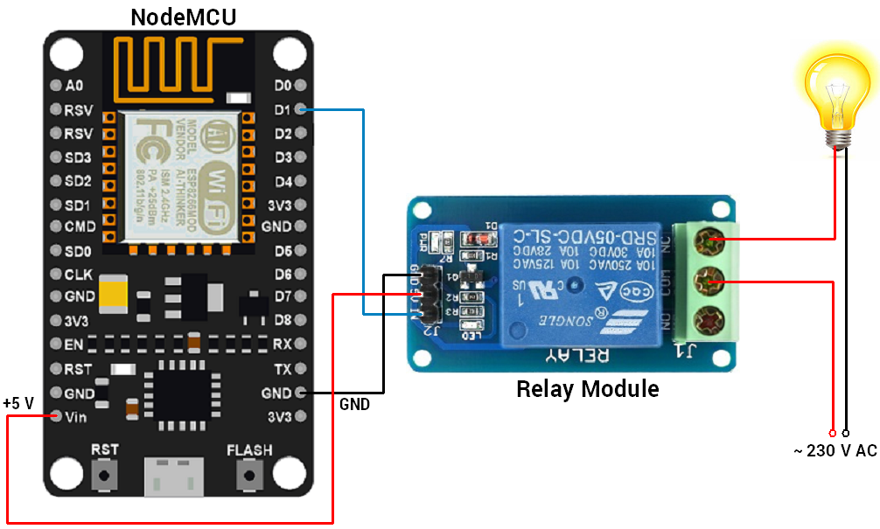
Con Setup

Slide 4
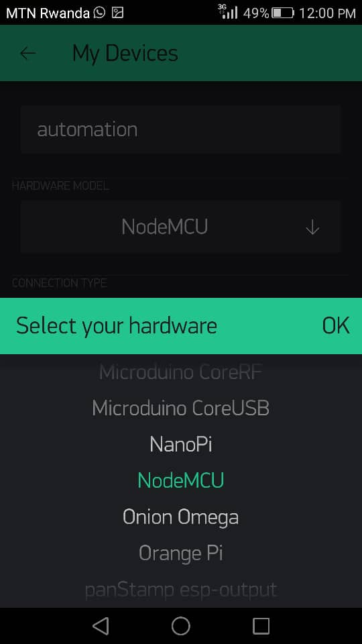
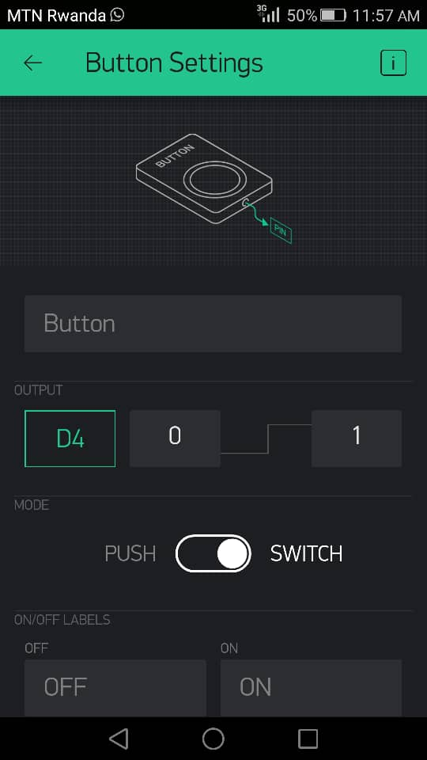
BLYNK
We have installed blynk in our Mobile Phone and we set it up to control the bulb using our Wi-Fi. After setting up blynk, they gave us Auth Token for connecting our Adruino IDE and bylnk.

Slide 5
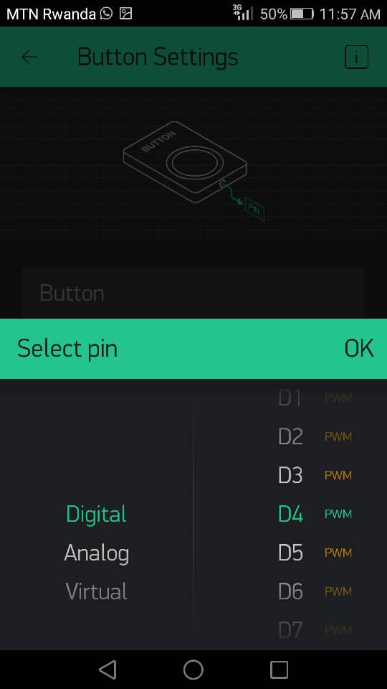
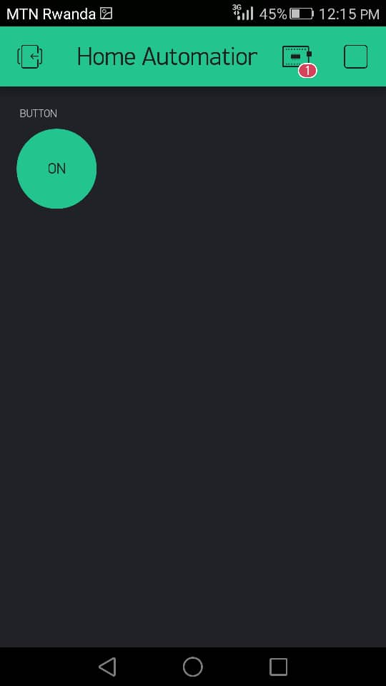
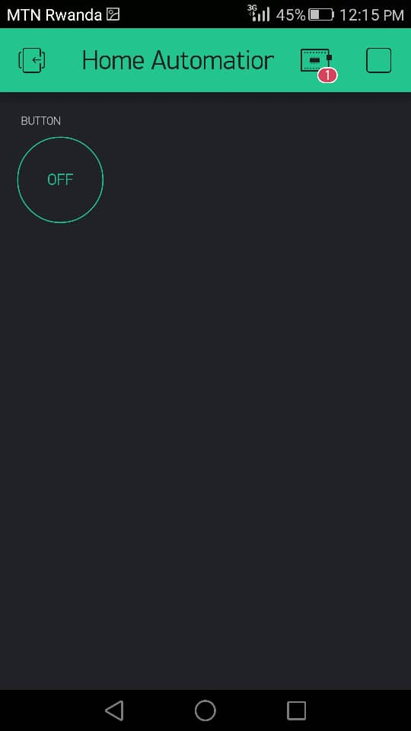
After Setting up blynk we created a new project we calle it Home Automation and we setup button for switch ON and OFF our Bulb.

Slide 6
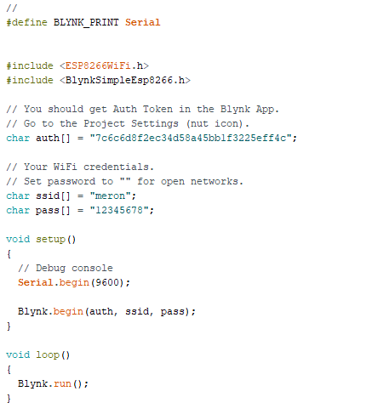
Codes

Slide 7
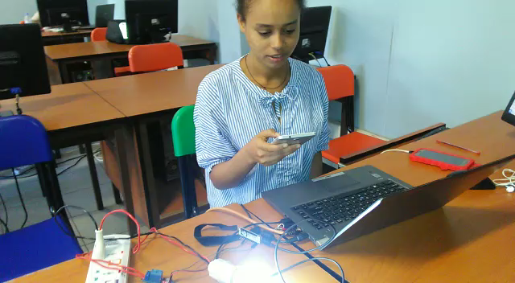
Watch the Video

Slide 8
धन्यवाद

